Slide 1
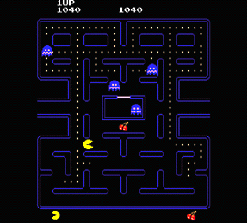
CSE 380 – Computer Game Programming
Real-Time Game Architecture
PacMan by Midway, released 1980

Slide 2
Game-specific code vs. Game-engine code
Try to make code that’s flexible, maintainable, reusable, etc.
  some things may be common for all games
    rendering, collision detection, game loop, etc.
  some things are game-specific
    game rules, event responses, etc.
Game Framework
Game Loop
Timing
GUI
AI
Level loading
Physics
Game #1
custom use
Game #2
custom use

Slide 3
The Game Loop
Games aim to run at consistent frame rates
What’s a frame rate?
  the average iterations through the game loop per second
Typical Frame rates:
  30 fps
  50 fps
  up to 100 fps

Slide 4



Simple game loop architecture
Start
Display Menu GUI
Exit to O/S
Initialization
Allocate memory
Load levels
…
Retrieve player input
Main logic
Collision Detection
Game AI
Physics
Cleanup
Deallocate
Close files
Exit to menu
Render next frame
What’s missing?
Timing

Slide 5
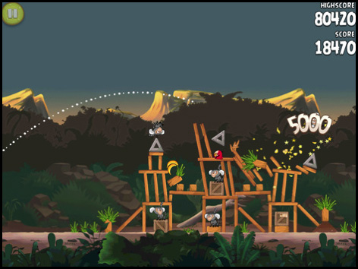
Dynamic Game Objects
Let’s address this early
Some objects move
  characters, missiles, vehicles, animals, etc.
Why move an object?
  player input
  AI decisions
  collisions/physics

Slide 6
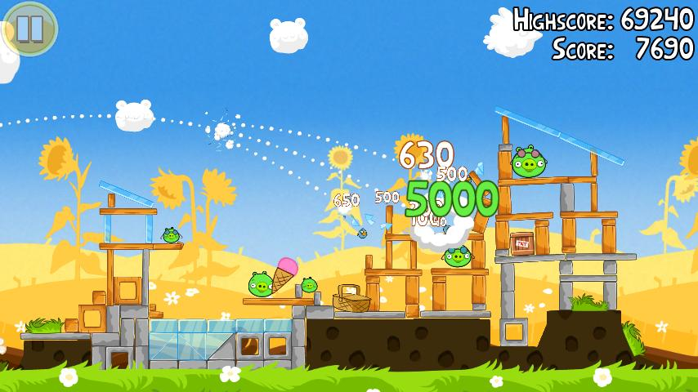
Design Strategy
We need a reliable, consistent approach to handle
Dynamic objects
Solution: velocities

Slide 7
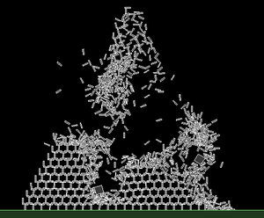
Velocities
In our games, all dynamic game objects (things that can move) will have x & y velocities

Slide 8
Each Frame
1. Process game input
  if necessary change player state and velocities
2. Process game AI
  if necessary change bot states and velocities
3. Process game physics
  if necessary change object(s) states and velocities
  for each collision we may need to correct velocities and positions
4. Update all dynamic object positions using velocities

Slide 9
The Game Loop
Each frame:
  get mouse input since last frame
    if mouse button clicked over button, execute response
  get key input since last frame
    determine key, if necessary, execute response
      perhaps update player state/velocity
      perhaps update game state (i.e. move to quit game state)
  for all bots, compute AI
    update bot states & velocities
  for all dynamic objects, compute physics
    update velocities & positions for collisions
  update all positions using remaining velocities
  render game
  calculate time of last game loop, clamp to desired frame rate

Slide 10
Game Program Complexity
Game programs are some of the most complex applications
  Basically they are ultra-high performance computer programs
Real-time, multithreaded, intelligent simulations displaying 30 frames per second or more
Speed is extremely important
Experienced game programmers sometimes use a coding style that optimizes program execution speed
Warning: Video game programming is 90 % data manipulation
  Careful data structure (simple is usually better)
  Very careful algorithm selection (efficient is better, duh!)

Slide 11
What do we need from Windows?
a main method
  WinMain for event driven applications
a Window
messages concerning events
  WinProc tells us about important stuff
easy ways of getting mouse & key input data
  we’ll do this with Windows method, not DirectX
We’ll do everything else in DirectX
  including making buttons and other controls

Slide 12
This semester’s Game class
Will the focal point
It will have:
  the game loop
  the game state
    i.e. game in progress, paused, quitting, etc.
  access to everything:
    GameDataLoader, GameGraphics, GameGUI, GameInput, GameOS, GameStateManager, etc.

Slide 13
What does a game state dictate?
What to draw?
  which Menu/GUI controls
Is the game in progress?
  if no, skip the game logic code
How to respond to user input?
  know which buttons are being clicked
Let’s look at a simplified Game class

Slide 14
A little UML
Game
-$ gameIsActive:bool
*window:GameWindow
*timer:GameTimer
+ killGameApplication( )
+ runGameLoop( )
GameApp
+ $WinMain(…
GameTimer
-timerResolution:UINT
-targetMillisPerFrame:DWORD
-gameLoopStartTime:DWORD
- …
-*writer:TextFileWriter
+ resetTimer( )
+ timeGameLoop( )
GameWindow
windowHandle:HWND
wi:WINDOWINFO
applicationName:LPCWSTR
manageWindowsProc( )
$ WinProc (…

Slide 15
A game as a series of steps – one option
Game Initialization
Main game loop
  Menu initialization
  Menu loop
    Get input
    Render screen
    Update menu state
    Trigger game state changes
  Menu shutdown
  Level Initialization
  Level Game Loop
    Get input
    Run AI
    Collision detection/physics
    Update game objects
    Render screen
    Time loop
  Level shutdown
Game Shutdown

Slide 16
Game & Menu Initialization
Main game loop - Test Game State
  a. If Menu state:
    Get input
    Process menu events – if start game level
      Change to Game state
      Load level
  If Level state
    Get Input
    Process GUI events – if change levels/go to menu
      Change to Menu state or change level
      Unload current level
      Load level if necessary
    Run AI
    Collision detection/physics
    Update game objects – if change levels/go to menu
      Change to Menu state or change level
      Unload current level
      Load level if necessary
    Render screen
  Time loop
Game Shutdown
A game as a series of steps – another option

Slide 17
What is timing?
We don’t want our game loop to go too slow or too fast
  different machines have different capabilities
Solution:
  time your game loop
  synch games on all PCs
  synch all behavior to time, not to frames
How?
  “throttle frames” using high-resolution timer
  also called clamping
  we must do this for good animation and movement

Slide 18
Timers
Timers have varying resolutions. What’s that?
  precision of time measurements
Best we can hope for is 1 millisecond
One option, Windows Multimedia Library timers

Slide 19
High Resolution Timers
Steps for use
  Setup timer
    Ask system what best resolution is
      getMinSystemTimerResolution
    Setup timer requesting that resolution
      timeBeginPeriod
  Use timer once per frame
    Calculate time elapsed
    Calculate target time – actual time
    If > 0, loop too fast, what should we do?
    If < 0, loop too slow, what should we do?

Slide 20
Clamping a Loop
Options:
  inner loop until time is up
  sleep (preferred)
Note, some numbers in GameTimer don’t include the time we sleep
  these start with “sleepless”

Slide 21
Compensating for a slow machine
Options:
  improve program performance (duh)
    “tighten up the graphics”
  other than that:
    skip rendering
    interpolation
      scale movements
      scale animations
    live with it, make the player buy a new computer

Slide 22
void GameTimer::timeGameLoop()
{
gameLoopEndTime = timeGetTime();
loopTime = gameLoopEndTime - gameLoopStartTime;
gameLoopStartTime = timeGetTime();
sleeplessLoopTime = gameLoopEndTime - sleeplessGameLoopStartTime;
if (targetMillisPerFrame > sleeplessLoopTime)
{
sleepTime = targetMillisPerFrame - sleeplessLoopTime;
Sleep(sleepTime);
timeScaleFactor = 1;
}
else
{
sleepTime = 0;
timeScaleFactor = ((float)TARGET_FPS)/((float)sleeplessLoopRate);
}
sleeplessGameLoopStartTime = timeGetTime();
loopCounter++;
}

Slide 23
References
Introduction to Game Development
  Edited by Steve Rabin, Charles River Media

